Slide 1
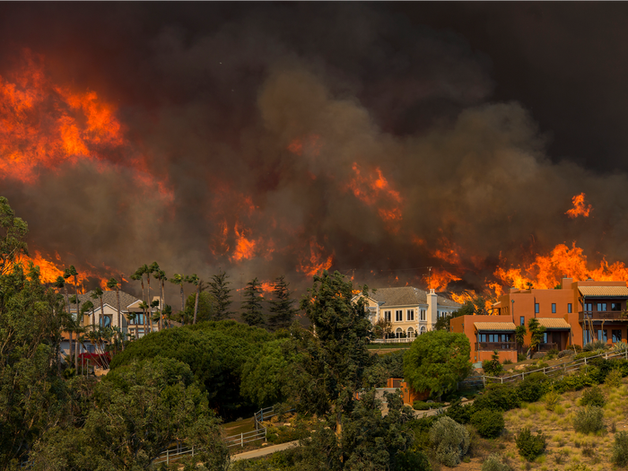
National University
ANA 699C
Wildfires: The Effects on Southern California
A Team
(Aakriti Sinha, Adam LeBlanc, Aditi Bhujbal, Anna Mkrtchyan)
Date: Oct 27, 2022

Slide 2
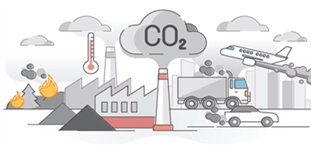


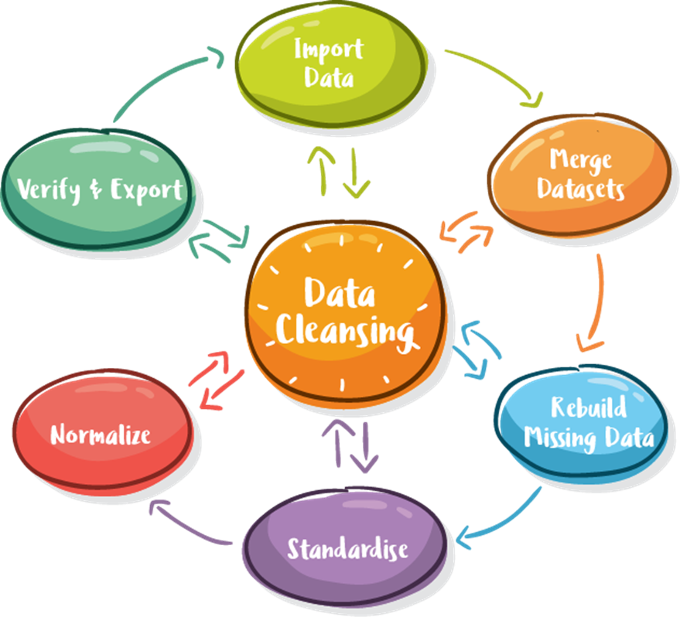
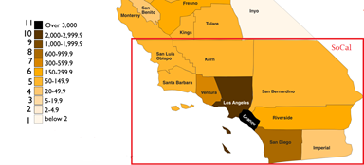







The A-team implemented various resources taught during the Course to Clean all data sources and conduct Exploratory Analysis.
Aakriti Sinha
Aditi Bhujbal
Anna Mkrtchyan
Adam LeBlanc

Slide 3
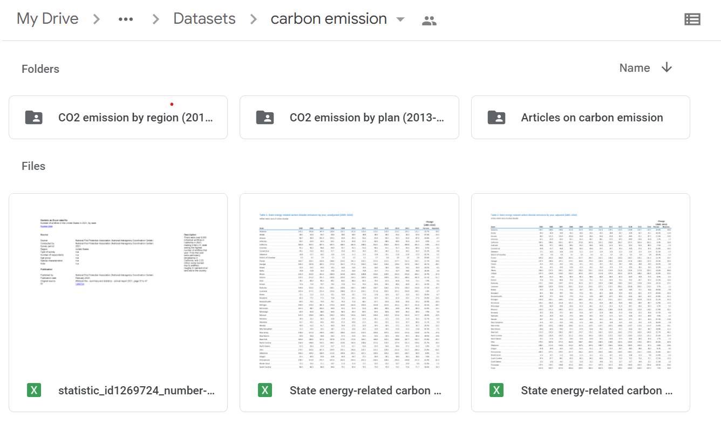
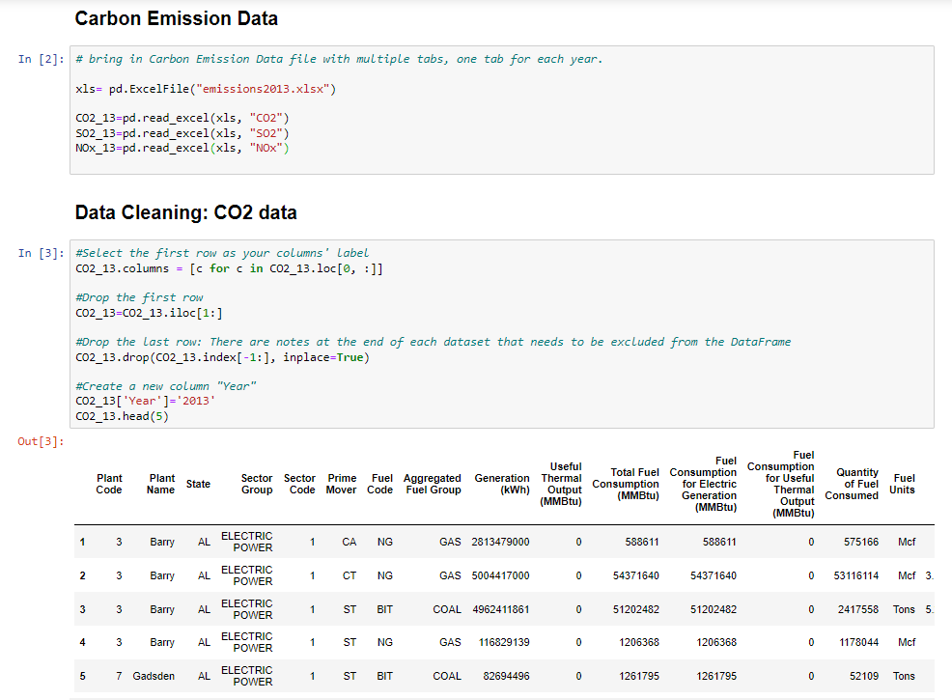
All Carbon Emission Excel files are being cleaned using Python to create a single dataset.

Slide 4
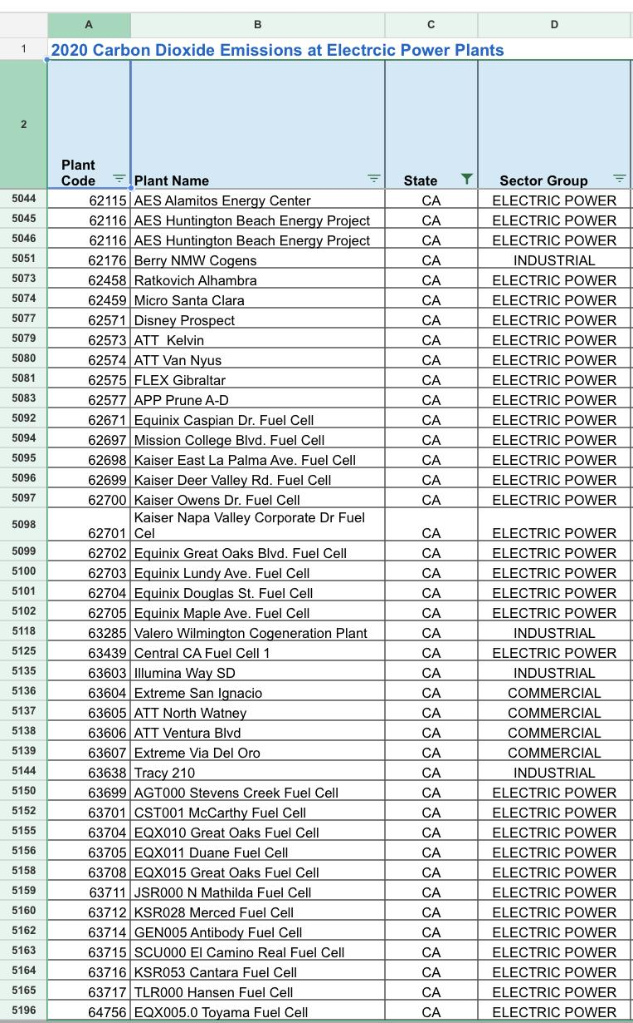

Google API is being leveraged for cleaning Carbon Emission Plant data for the Southern California Region, in order to create a single dataset.

Slide 5






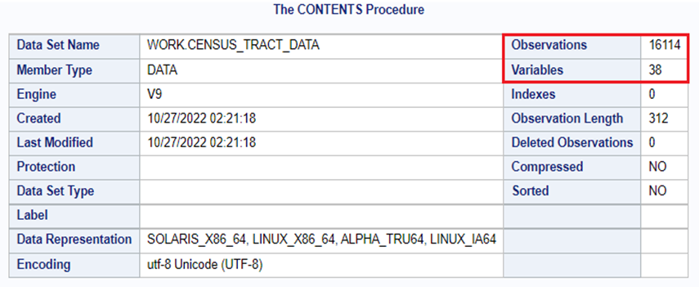
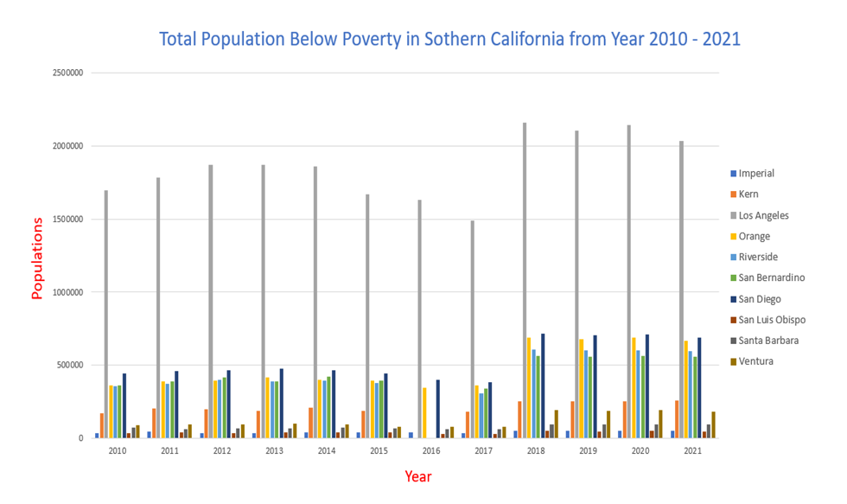
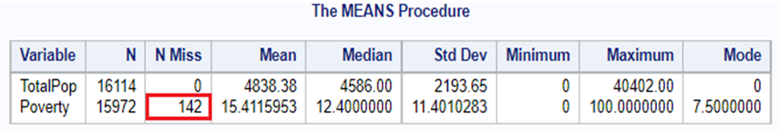

SAS is being utilized for the Cleaning and Exploratory Analysis of the Population Data followed by merging all into single dataset.
U.S. Census Tract Data
Data collected from

Slide 6
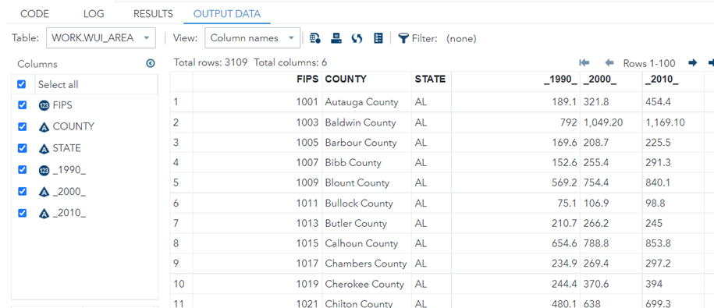
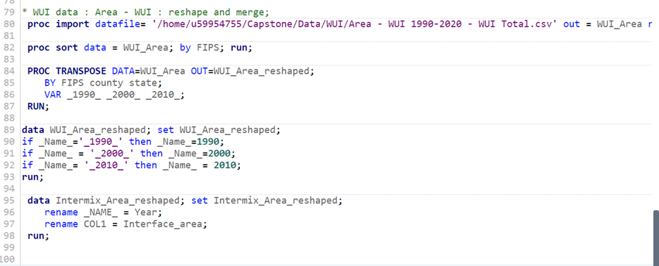
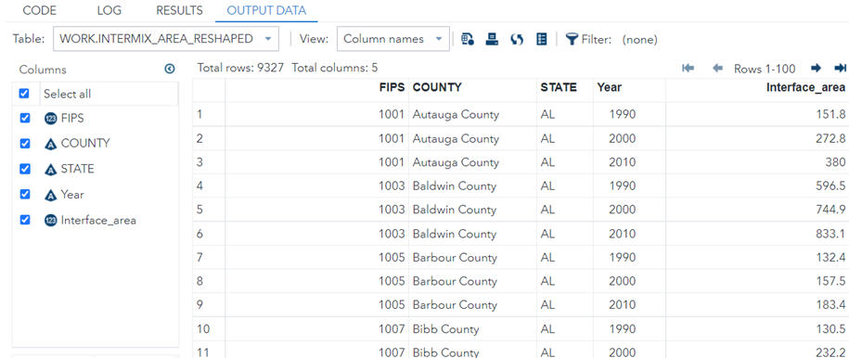
‘PROC TRANSPOSE’ procedure of SAS is used to perform long-to-wide transpose restructuring of WUI datasets and are finally merged into a single dataset.

Slide 7

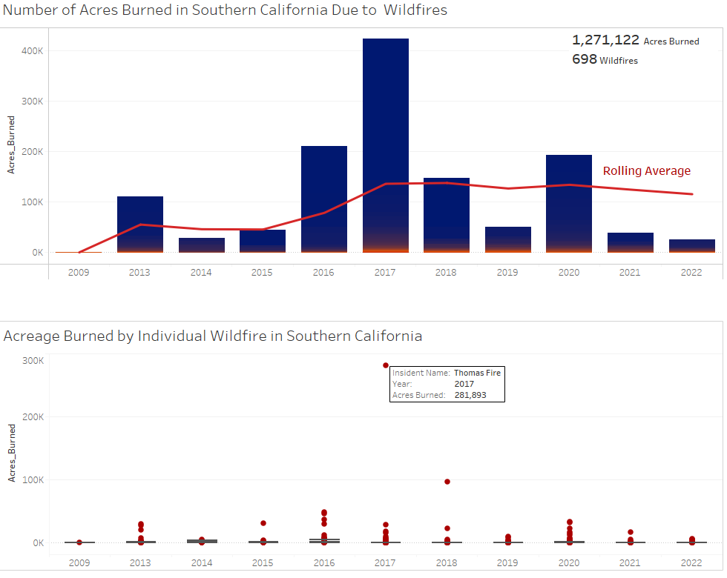
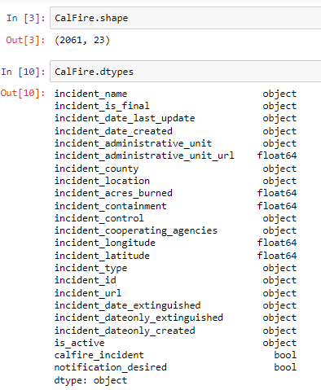
Using Python and Tableau, the Wildfire dataset obtained from CalFire website was cleaned and analysed to identify wildfire frequency variance, outliers and the rolling average.

Slide 8
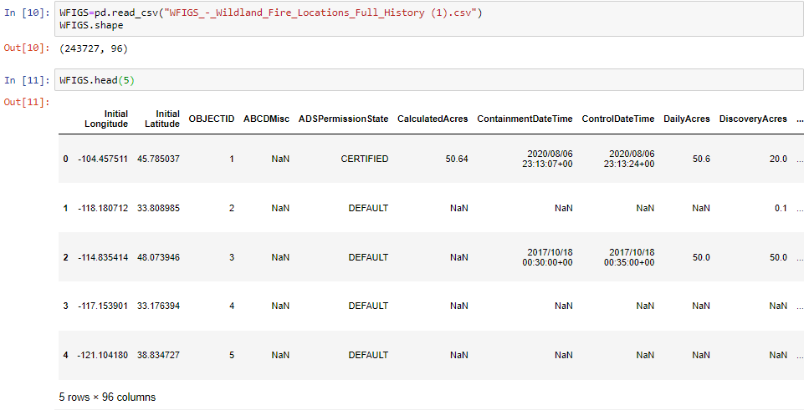


The National Interagency Fire Center provided a comprehensive dataset that contained 243,727 fire incidences that required extensive data cleaning, filtering and dealing with missing values, prior merging with CalFire dataset.

Slide 9
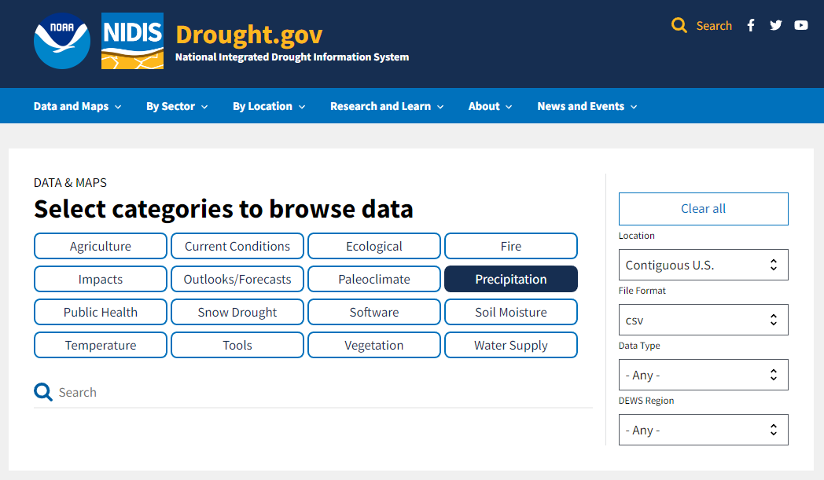
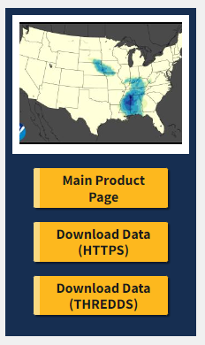
Data is being pulled from a shared repository of NOAA and NIDIS. The data is freely available to the public.

Slide 10
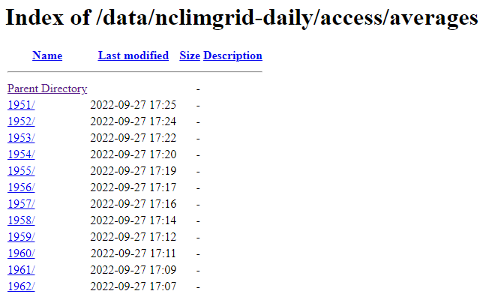
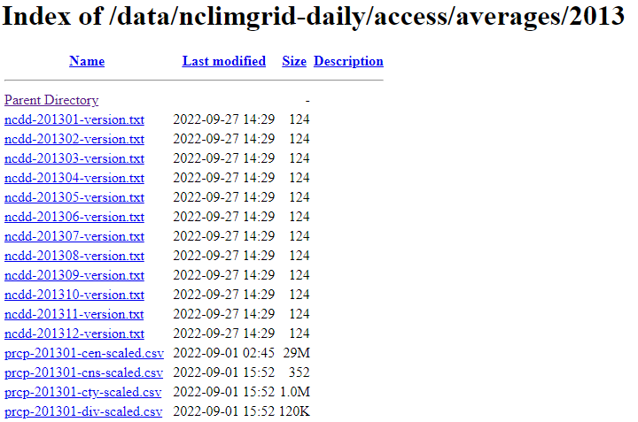
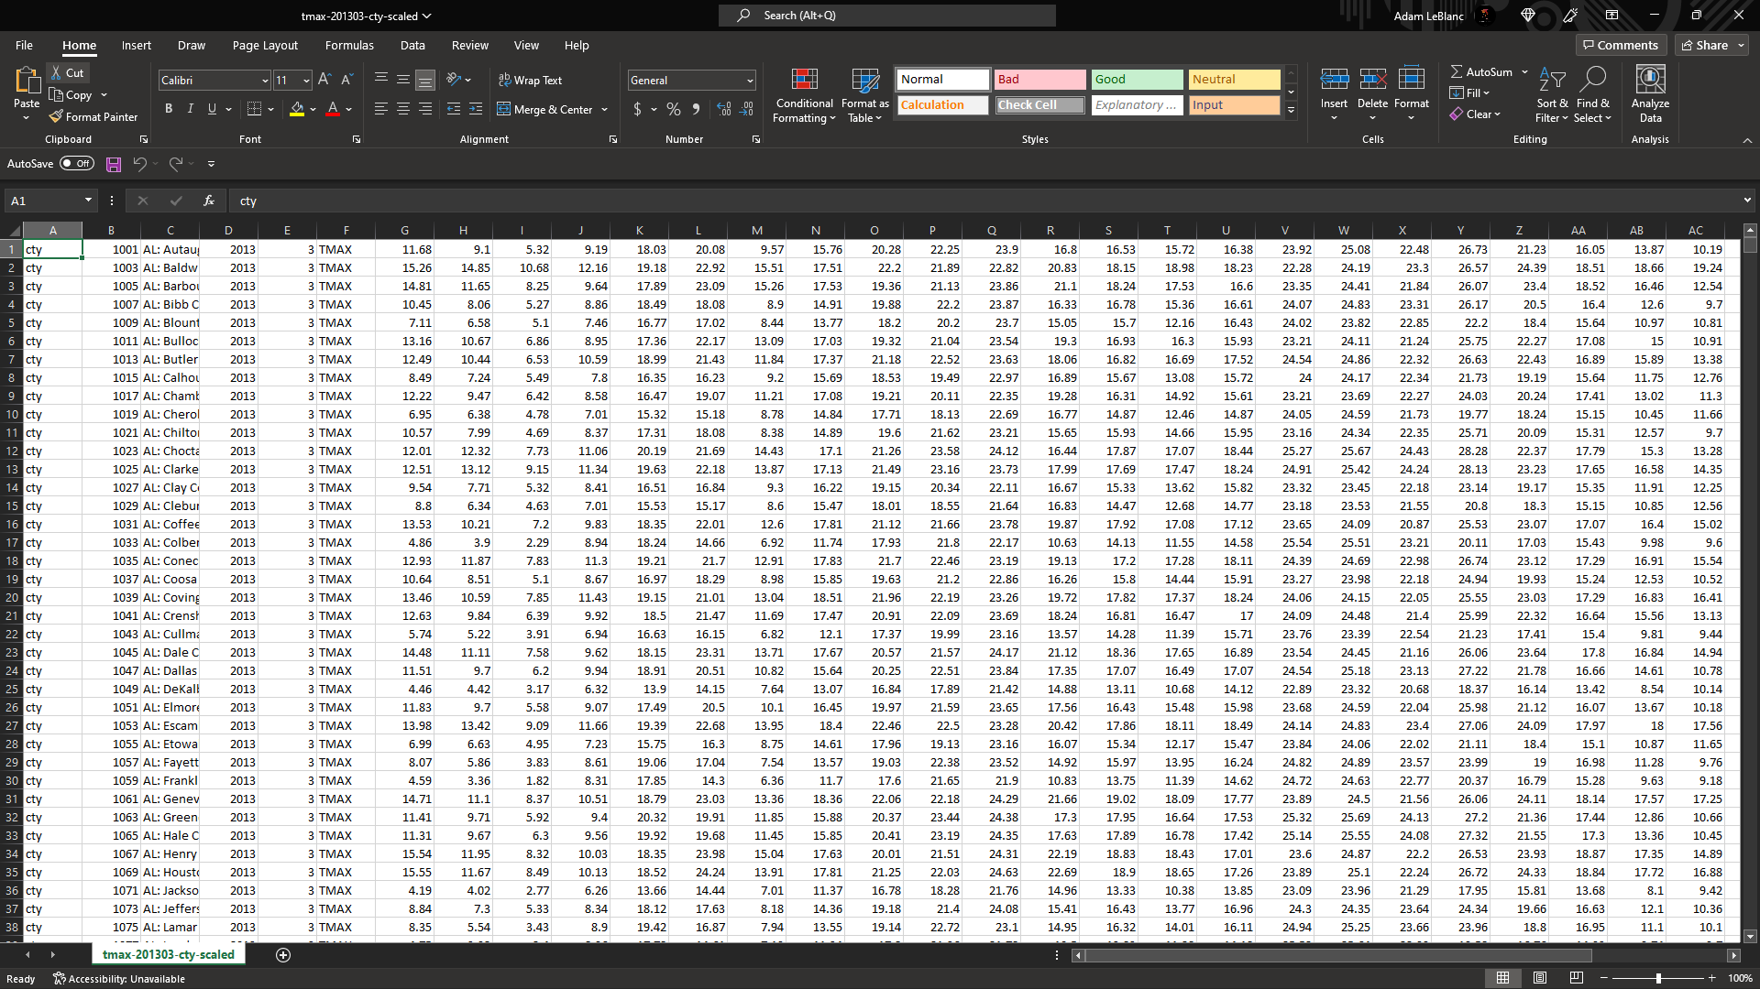
CVS files for U.S. Precipitation, Maximum Temperature, Minimum Temperature, and Soil Moisture, etc from 2013 to present are exported to Excel.

Slide 11
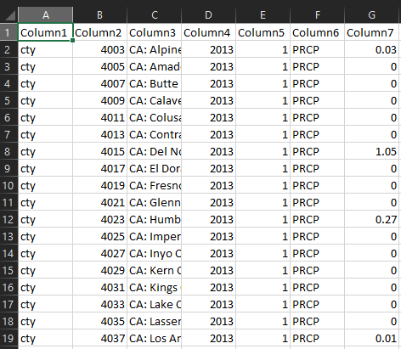
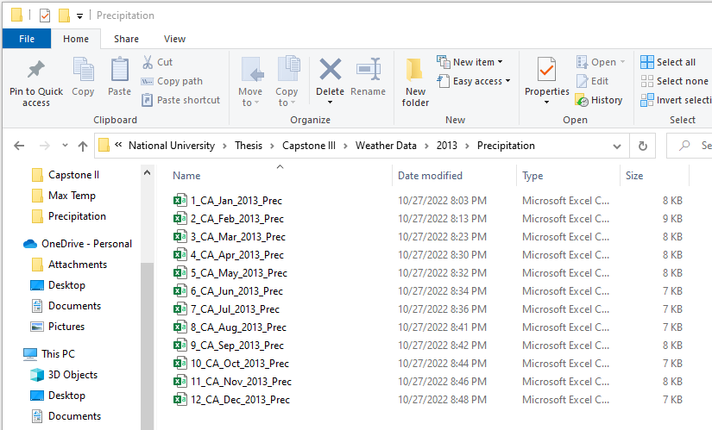
Using Excel the data is cleaned and only California variables remain. The files will be imported into SQL to remove all unneeded counties.

Slide 12
References:
2022 Fire Season Outlook. (n.d.). Retrieved October 27, 2022, from https://www.fire.ca.gov/incidents
Kent State University (n.d.) SAS TUTORIALS: TRANSPOSING DATA USING PROC TRANSPOSE Retrieved from https://libguides.library.kent.edu/SAS/TransposeData
SAS Help Center (n.d.) CONTENTS Procedure. Retrieved from https://documentation.sas.com/doc/en/pgmsascdc/9.4_3.5/proc/n1hqa4dk5tay0an15nrys1iwr5o2.htm
SAS Help Center (n.d.) MEANS Procedure. Retrieved from https://documentation.sas.com/doc/en/pgmsascdc/9.4_3.5/proc/n1qnc9bddfvhzqn105kqitnf29cp.htm
US Carbon Monitor. Carbon monitor. (n.d.). Retrieved from https://us.carbonmonitor.org/
U.S. Energy Information Administration - EIA - independent statistics and analysis. Emissions by plant and by region. (2022). Retrieved from https://www.eia.gov/electricity/data/emissions/
U.S. Energy Information Administration - EIA - independent statistics and analysis. Energy-Related Carbon Dioxide Emissions by State, 2005 - 2016. (2019). Retrieved from https://www.eia.gov/environment/emissions/state/analysis/
WFIGS - Wildland Fire Locations Full History. (n.d.). Retrieved October 23, 2022, from https://data-nifc.opendata.arcgis.com/datasets/nifc::wfigs-wildland-fire-locations-full-history/explore?location=-0.000000,0.000000,2.37
Questions?

